Slide 2
 Repeat after me...
This analytical procedure involving an extraction factor works only if K is a constant. That is, the equilibrium relationship is a straight line.

Slide 4
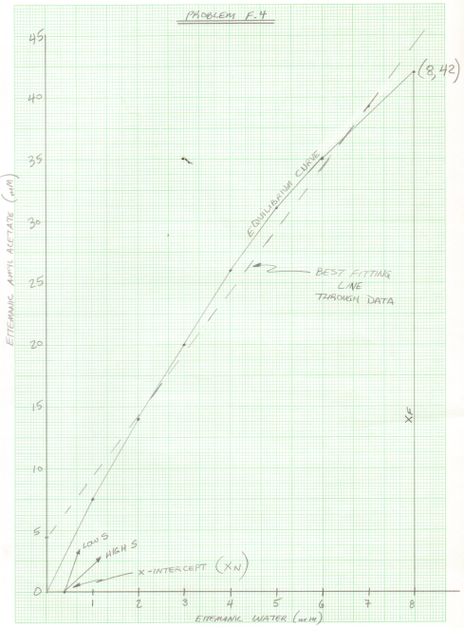

Slide 8
